Slide 1
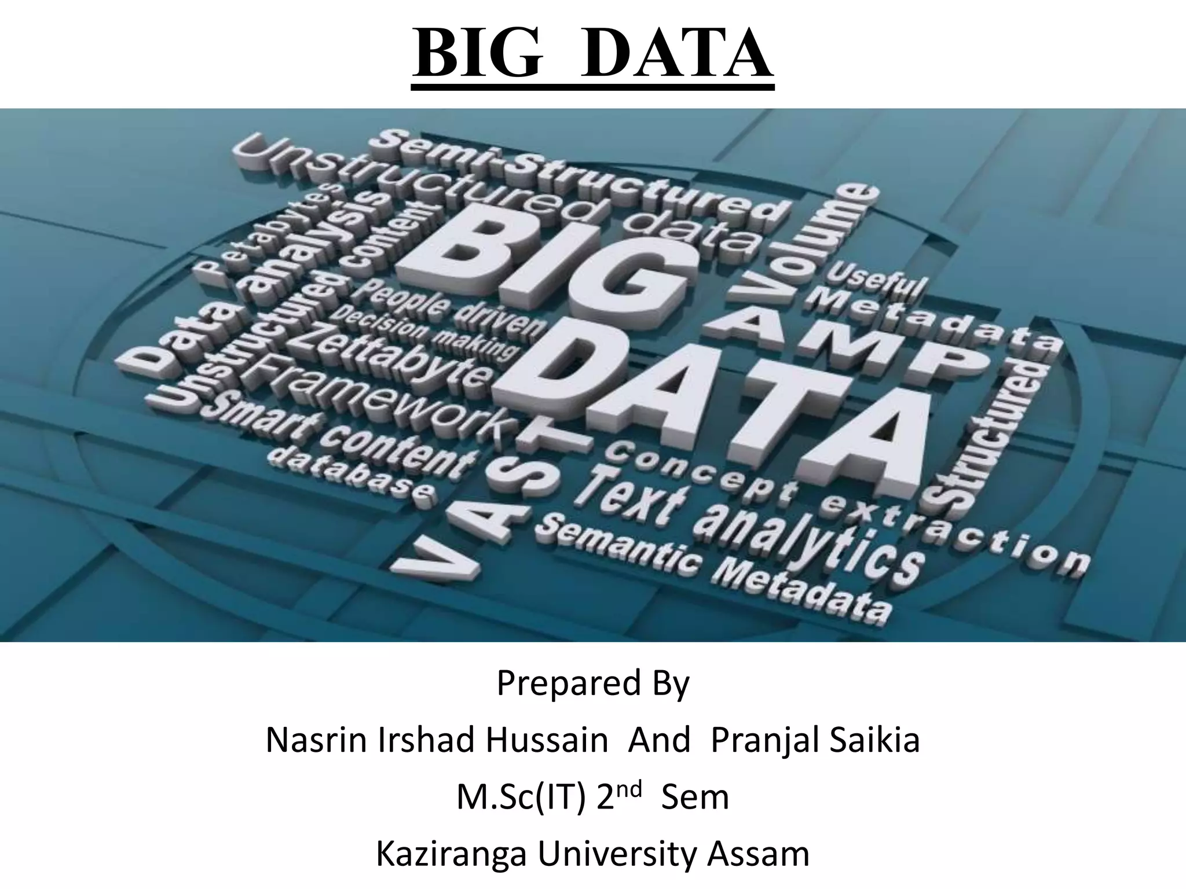
BIG DATA

Slide 2
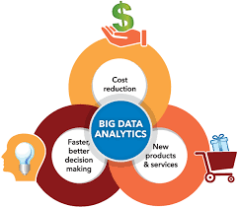
BIG DATA ANALYSIS
PRESENTED BY
ABINAYA J
DEVIKA K
SIVASTHRUTHI M
VENOTHAPRIYAA S

Slide 3
INTRODUCTION
Big data is a collection of massive and complex data sets and data volume that include the huge quantities of data, data management capabilities, social media analytics and real-time data. Big data analytics is the process of examining large amounts of data. There exist large amounts of heterogeneous digital data. Big data is about data volume and large data set's measured in terms of terabytes or petabytes. This phenomenon is called Bigdata. After examining of Bigdata, the data has been launched as Big Data analytics. In this paper, presenting the 5Vs characteristics of big data and the technique and technology used to handle big data.

Slide 4
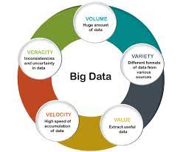
CHARACTERISTICS OF BIG DATA
Big Data contains a large amount of data that is not being processed by traditional data storage or the processing unit. It is used by many multinational companies to process the data and business of many organizations. The data flow would exceed 150 exabytes per day before replication.
There are five v's of Big Data that explains the characteristics.
5 V's of Big Data
Volume
Veracity
Variety
Value
Velocity

Slide 5
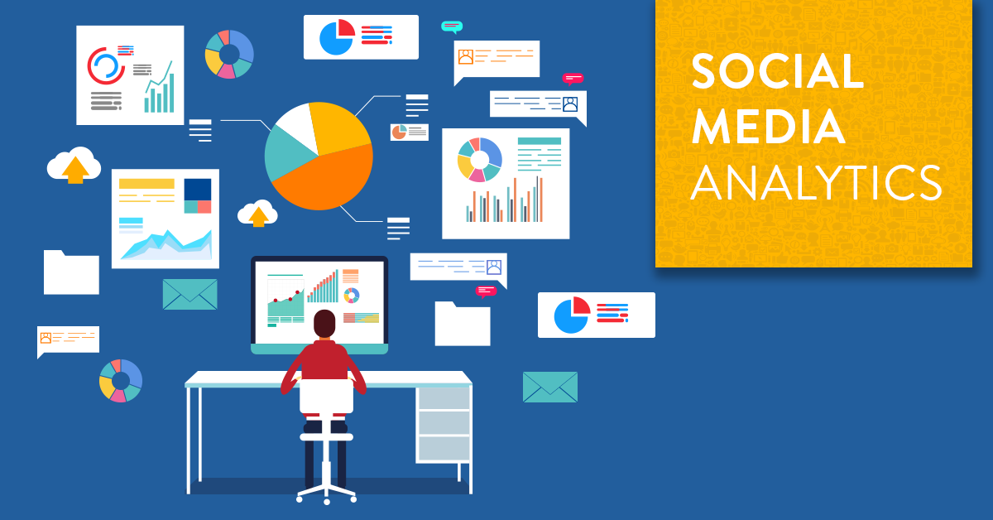
DATA SELECTION
Data selection is defined as the process of determining the appropriate data type and source, as well as suitable instruments to collect data. Data selection precedes the actual practice of data collection. This definition distinguishes data selection from selective data reporting (selectively excluding data that is not supportive of a research hypothesis) and interactive/active data selection (using collected data for monitoring activities/events, or conducting secondary data analyses). The process of selecting suitable data for a research project can impact data integrity.

Slide 6
DATABASE SETUP
Create an IBM cloud account.
Log in to IBM cloud.
Choose a database service.
Create a database instance.
Database configuration.
Import data.
Data management and scaling.
Backup and recovery.
Monitoring and maintenance.
Access and integration.
Security and compliance.
Cost management.

Slide 7
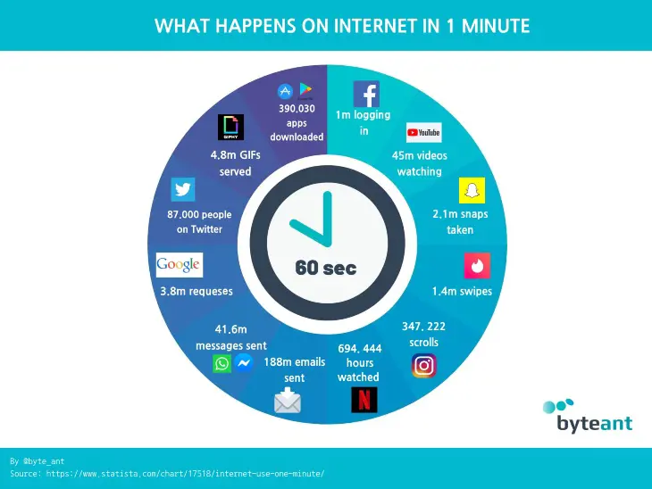
DATA EXPLORATION
Data exploration refers to the initial step in data analysis in which data analysts use data visualization and statistical techniques to describe dataset characterizations, such as size, quantity, and accuracy, in order to better understand the nature of the data.

Slide 8
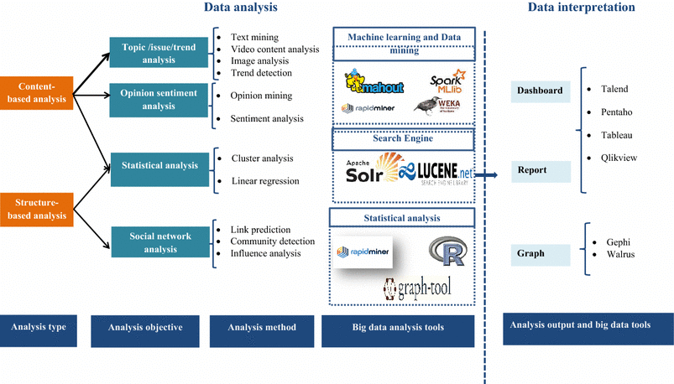
ANALYSIS TECHNIQUES
Regression analysis
Monte Carlo simulation
Factor analysis
Cohort analysis
Cluster analysis
Time series analysis
Sentiment analysis

Slide 9
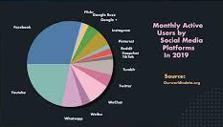
VISUALIZATION
One way to use data visualization in social media is to create interactive charts and graphs that allow your audience to explore, manipulate, and customize the data. This can make your data more relevant, personal, and fun for your audience, as well as increase their engagement and retention.

Slide 10
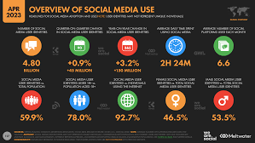
BUSINESS INSIGHTS
A business insight combines data and analysis to make sense of and deepen your understanding of a situation, giving your company a competitive edge. · You must take into account things like KPIs and strategic corporate goals if you want to get practical business insights from data.

Slide 11


